Slide 1
Factors affecting mortality associated with heart failure: unsupervised machine learning model
Vladimir Bykov

Slide 2
Dataset
The dataset contains medical records of 299 heart failure patients, where each patient is characterized by 13 clinical features.
Heart failure:
Heart is unable to maintain sufficient blood flow to meet the body's needs.

Slide 3
Clinical features used in the model
- age: age of the patient (years)
- anaemia: decrease of red blood cells or hemoglobin
- high blood pressure: if the patient has hypertension
- creatinine phosphokinase (CPK): level in the blood. Marker of muscle tissue damage such as in myocardial infarction (heart attack)
- diabetes
- ejection fraction: percentage of blood leaving the heart at each contraction

Slide 4
Clinical features used in the model
- platelets: platelets (type of cells) in the blood. Blood ability to clote
- sex: 0- female, 1- male
- serum creatinine: level in the blood. Normal muscle breakdown product, high levels- kidney function decreased and/or muscle breakdown accelerated.
- serum sodium: level in the blood. Low sodium level is associated with an increase in total body fluid seen in patients with heart failure.
- smoking
- death event: if the patient deceased during the follow-up period

Slide 5
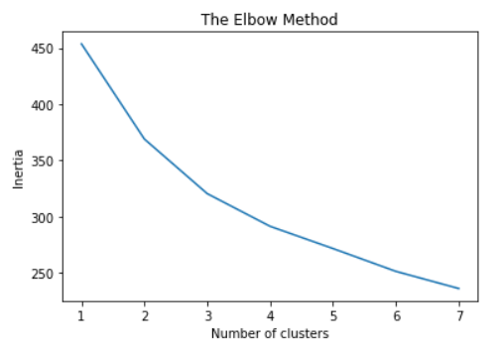
Number of clusters
Two scaling techniques were applied, Standard and MinMax. MinMax yielded more elbow-shape graph. Run K-means clustering with 3 and 4 clusters, 4 was more optimal.
Inertia with 4 clusters = 294.83

Slide 6
Clustering
I have selected 4 clusters as a reasonable number which is enough to explain sufficient amount of variance in the data
CL-1: cluster conferring highest rist of dying
CL-2: the best prognosis, recovery
CL-3: intermediate recovery, non-smokers
CL-4: intermediate recovery, smokers

Slide 7
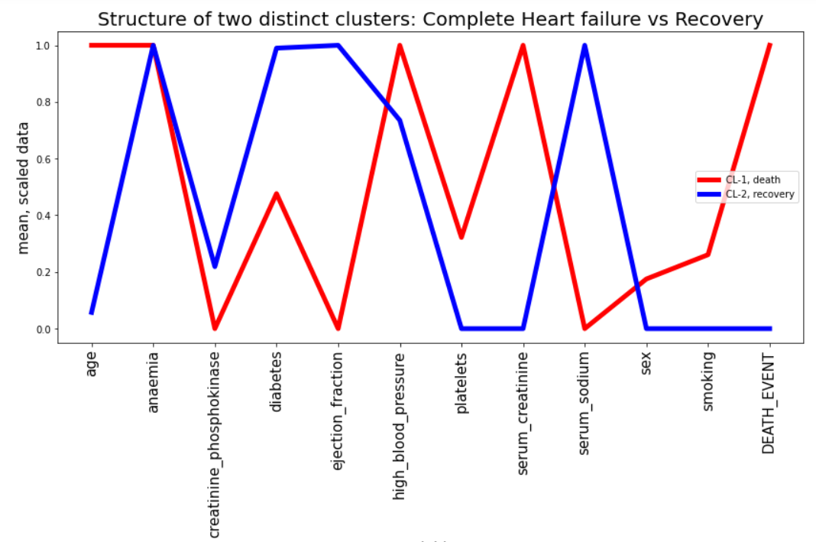
Cluster structure: means of the scaled data for each feature

Slide 8
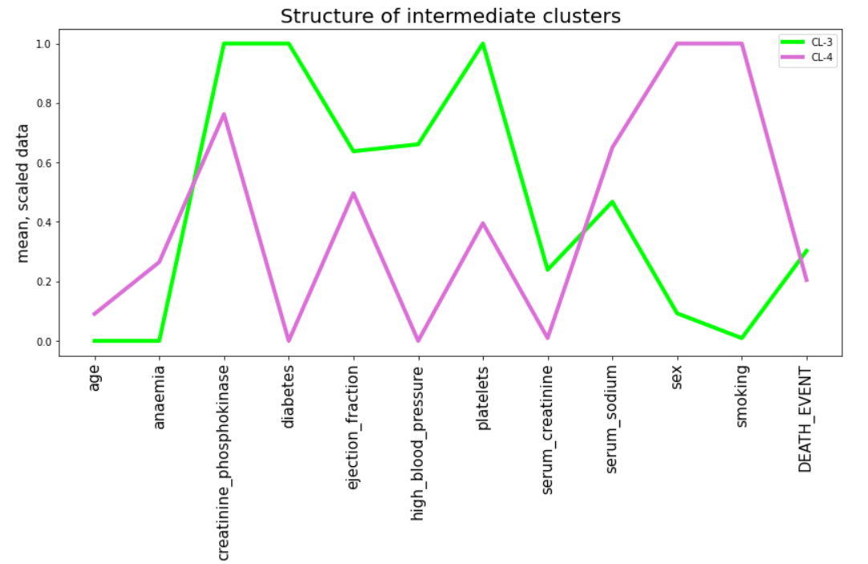
Cluster structure: means of the scaled data for each feature
Non-smokers
Smokers

Slide 9
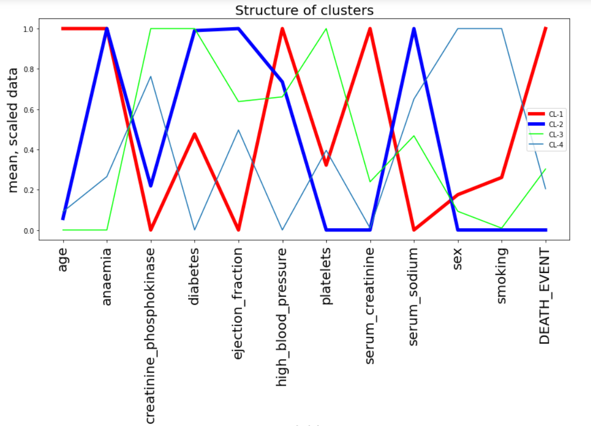
All clusters together
Death
Recovery
Non-smokers
Smokers

Slide 10
Conclusions
The risk of dying after heart failure was strongly associated with older age, low heart ejection fraction, high blood pressure, high serum creatinine level, low serum sodium level
Heart failure patients with such characteristics need more medical attention in order to improve their prognosis

Slide 11
Challenges / Learnings / Highlights
Generation cluster structures and associated data manipulations

Slide 12
Thank you

